Slide 1

Analysing elevation, soil and land cover
Morocco
Rachid Berghout

Slide 2
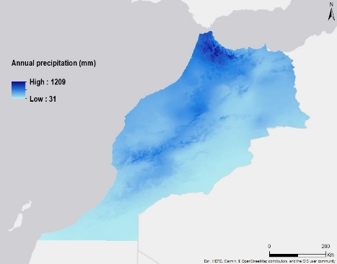
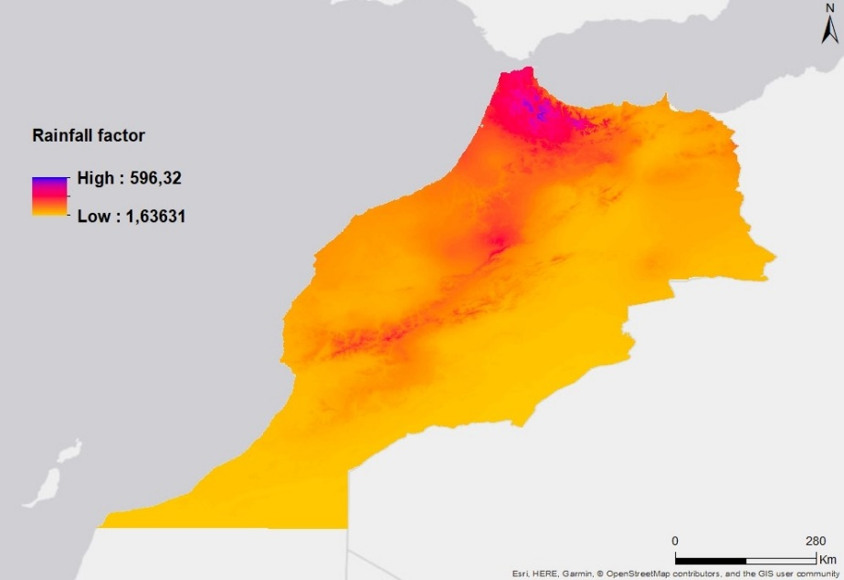
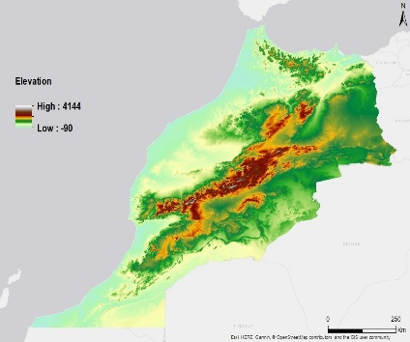
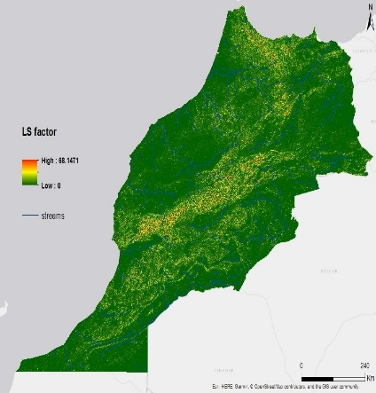
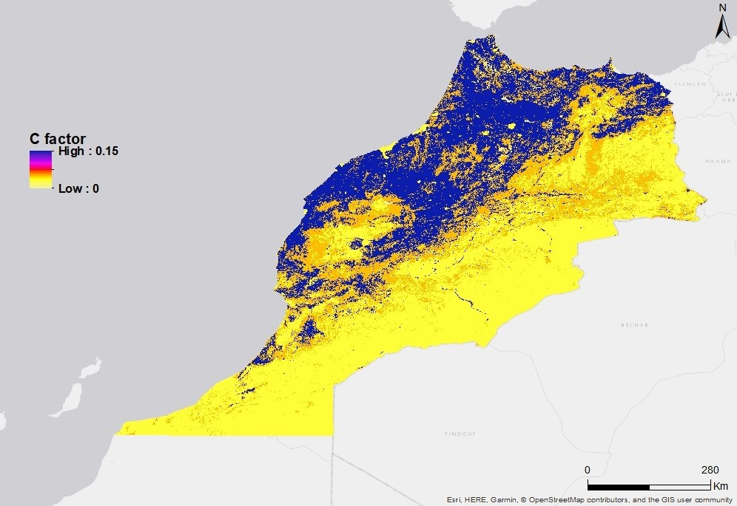
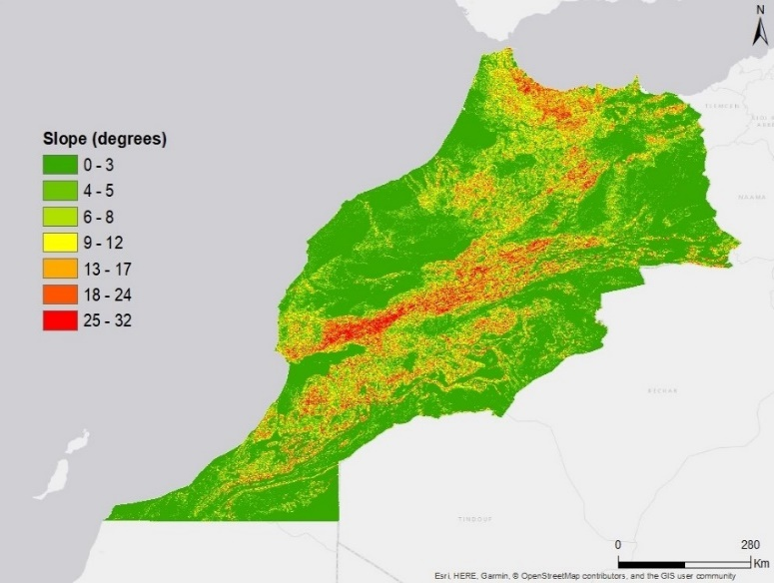
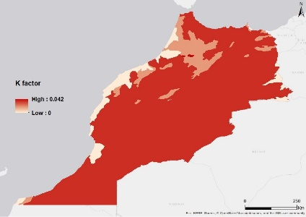
Morocco
Elevation
Soil
Land Cover

Slide 3

Soil Erosion
LS Factor
Soil Texture
Slope
K Factor
Elevation
Land Cover
Rainfall Factor
C Factor
Annual precipitation

Slide 4
Soil Erosion
The universal soil loss equation (USLE) proposed by Wischmeier and Smith in (1978) was the most widely used model in predicting the loss of soil: A (ton/ha/year)
R
K
LS
P
R factor
K factor
C
Mj.mm/ha.h.year
Ha.h/ha.mj.mm
LS factor
P factor
dimensionless
C factor
support practice factor
dimensionless
dimensionless
A = R × LS × K × C × P
Notes:
Soil erosion : displacement of the upper layer of soil
The greater the intensity and duration of the rain storm, the higher the erosion potential

Slide 5
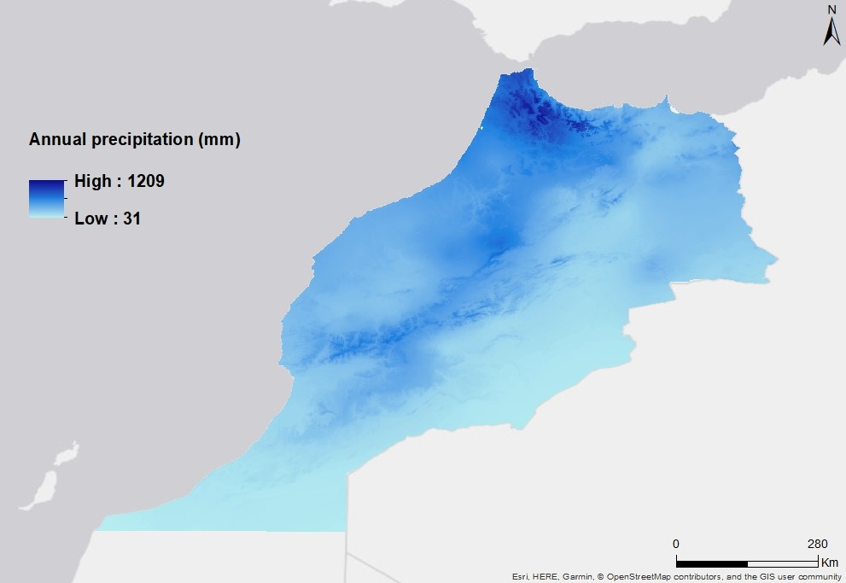
Annual precipitation
The northwest is on average, more watered than the rest of the country.
The average annual precipitation varies considerably :
It can reach more than 800 mm on the reliefs, while it does not exceed 300 mm on the surrounding plains.

Slide 6
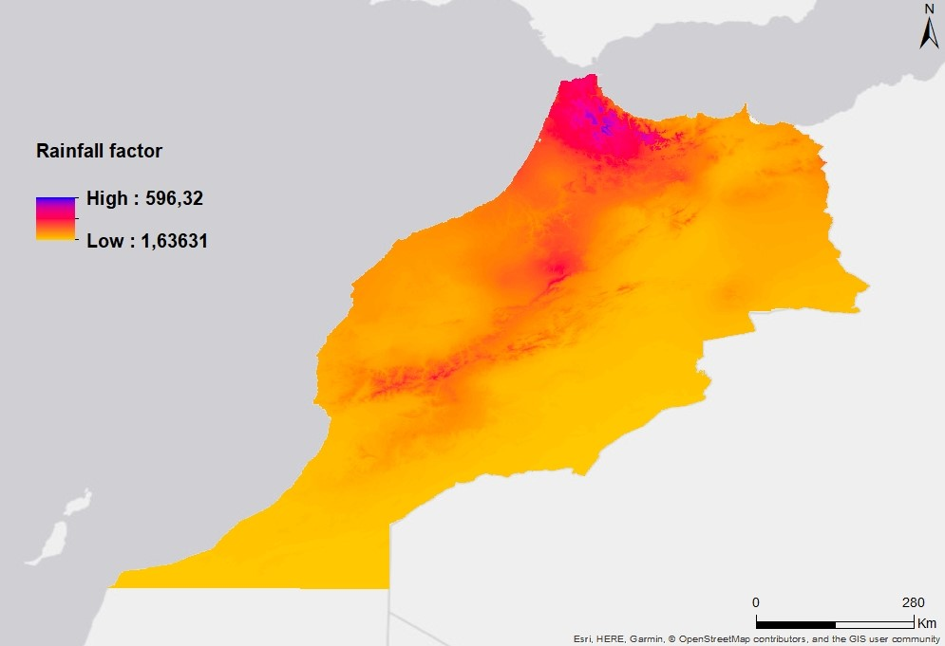
Rainfall factor
R is the rainfall and runoff factor.
The greater the intensity and duration of the rain storm, the higher the erosion potential (Stone and Hilborn 2012).
defined as the product of the kinetic energy of a storm and its maximum intensity during a 30 min intervall.

Slide 7
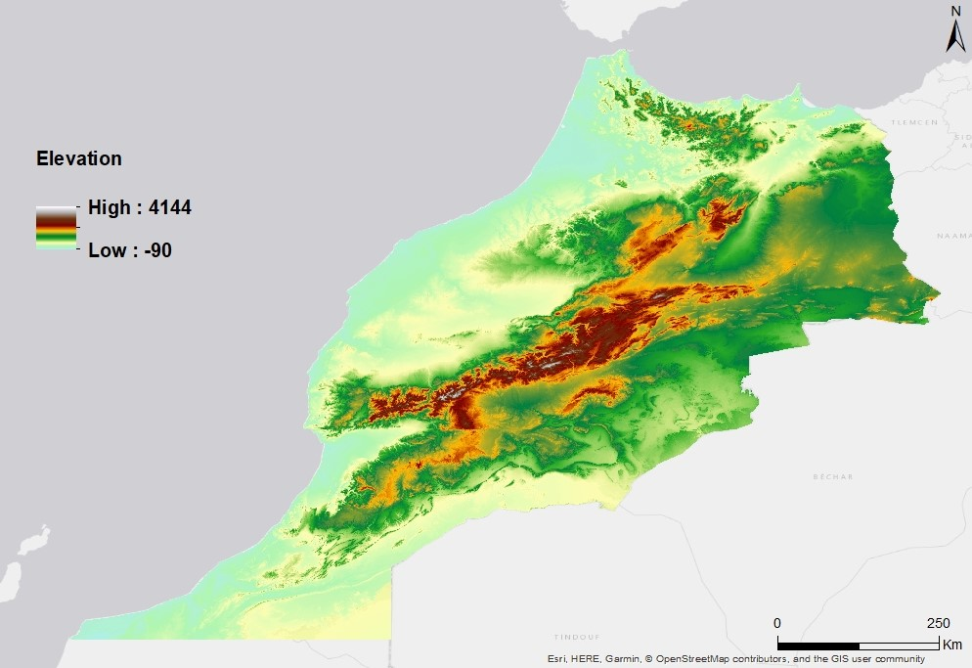
Elevation
The northern coastal plain along the Mediterranean, varying in elevation up to about 2400 m.
The rich plateaus, from the Atlantic coast in the southwest to Algeria and the Mediterranean in the northeast.
The Atlas Mountains, with an average elevation of 3,350 m, contain some of the highest peaks of North Africa, including Mt. Toubkal (4,165 m)

Slide 8

Slope
Much of Morocco's landscape is mountainous with slopes that gradually transition into plateaus and valleys. The Atlas mountains dominate the central part of the country, while the Rif mountains make up the northern edge

Slide 9

Ls factor
LS is the slope length-gradient factor.
The LS factor represents a ratio of soil loss under given conditions to that at a site with the “standard” slope steepness of 9 % and slope length of 22.13 m.
The steeper and longer the slope, the higher the risk for erosion (Stone and Hilborn 2012).

Slide 10
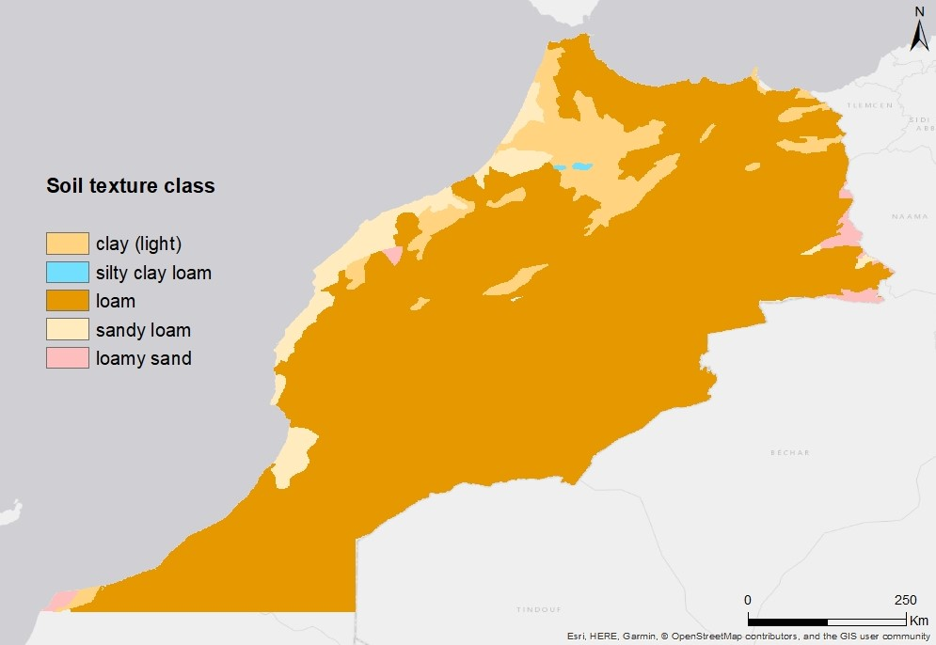
Soil texture
significant spatial distribution of soil texture.
Soil texture in Morocco is dominted by loam (a fertile soil of clay and sand containing humus).
Sandy loam widespread along the Mediterranean coast.

Slide 11

k factor
K is a measure of the susceptibility of soil particles to detachment and transport by rainfall and runoff.
Texture is the principal factor affecting K, but structure, organic matter and permeability also contribute (Stone and Hilborn 2012).

Slide 12
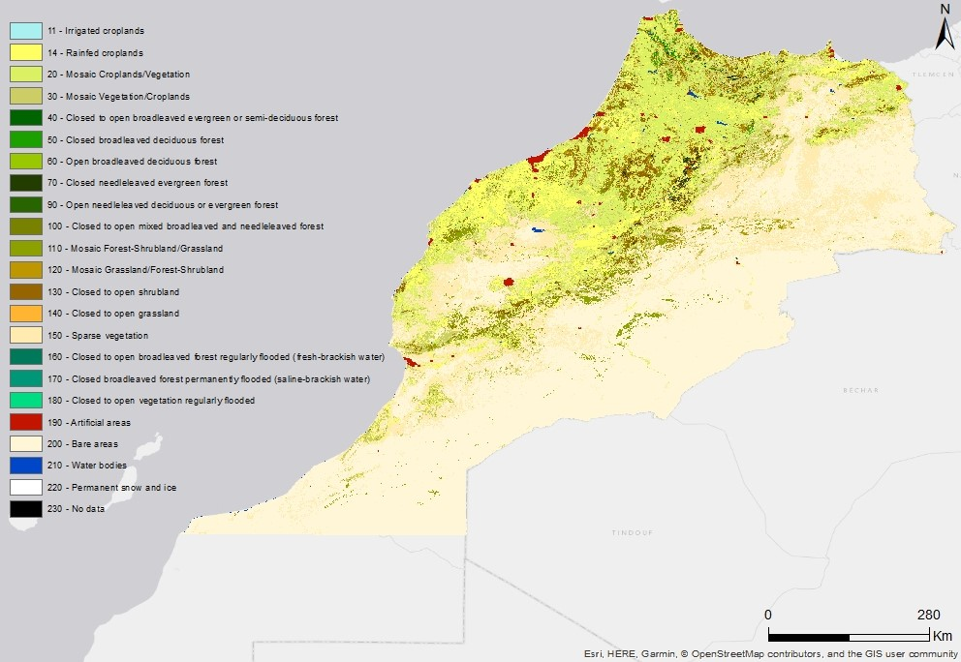
Land cover
The majority of land in Morocco falls into the sparsely vegetated (NDVI* values between 25 and 50) and bare (values< 25) classifications.
The highest NDVI values (>126), representing dense vegetation, are located in the mountains and in urban areas on the Mediterranean coast.
* normalized difference vegetation index

Slide 13
c factor
C is the crop/vegetation and management factor.
It is used to determine the relative effectiveness of soil and crop management systems in terms of preventing soil loss.

Slide 14
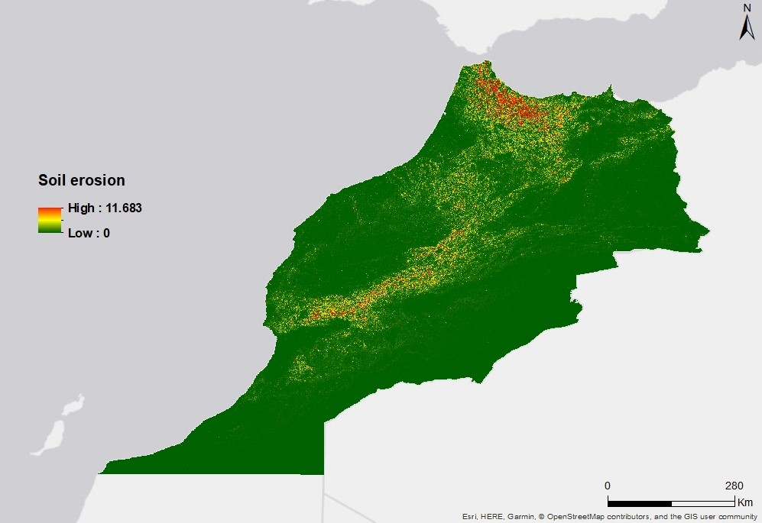
Soil erosion
The present study allows us to quantify and map potential erosion throughout Morocco.
The results show that approximately more than 80 % of the study area has a low risk of erosion.
The surroundings of the Rif Mountains are vulnerable to erosion.
(t/ha/year)

Slide 15
References
https://www.nationsencyclopedia.com/Africa/Morocco-TOPOGRAPHY.html
http://www.screentex-int.com/who-we-are/derbigum/etude_de_la_pluviometrie_au.pdf
https://www.sciencedirect.com/science/article/pii/S0098300404001396
https://link.springer.com/article/10.1007/s40808-016-0105-y
https://en.wikipedia.org/wiki/Soil_erosion
https://www.researchgate.net/figure/Morocco-Land-Cover-USGS-Land-Cover-Land-Use-Modified-Level-2-for-1993-Major-Cities_fig1_278299546
http://www.fao.org/countryprofiles/maps/map/en/?iso3=MAR&mapID=608

Slide 16
Thank You

